Slide 1
Bayesian Project Spring 2020
Peter Butler

Slide 2
Objective & Methods
Classification Problem: will a credit card application be accepted or not?
Logistic Regression
Use Bayesian Methods to obtain posterior distributions
Metropolis
No U-Turn Sampler (NUTS)

Slide 3
Data
Obtained from UCI Machine Learning Repository
Binary Response (application approved/rejected)
10 Predictors: 6 continuous, 4 binary
Most binary predictors evenly distributed
Continuous predictors skewed right
~45% of applications accepted, other 55% rejected

Slide 4
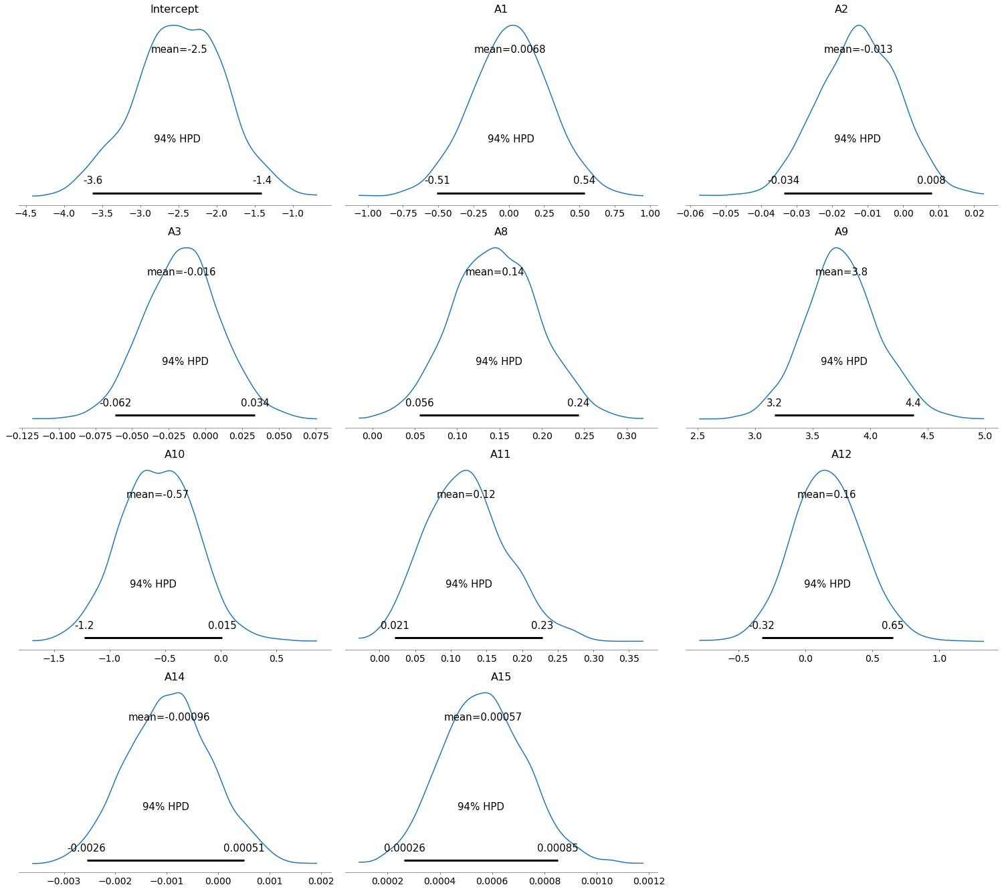
Posterior Distributions

Slide 5
Metropolis vs NUTS
 | Effective Sample Size (Metropolis) | Effective Sample Size (NUTS)
Intercept | 224 | 101
A1 | 1476 | 735
A2 | 264 | 124
A3 | 731 | 826
A8 | 1830 | 1279
A9 | 828 | 441
A10 | 693 | 415
A11 | 818 | 552
A12 | 1459 | 871
A14 | 583 | 377
A15 | 1713 | 1752

Slide 6
Prediction Results
Draw samples from posterior (n=1000)
Average prediction across the resulting Logistic Regression Models
Accuracy , F1_score ~0.86

Slide 7
Conclusions
Both methods were effective for establishing posterior distributions
NUTS converges faster than Metropolis
Logistic Regression model successful, but not exceptional. May need to use different predictors/dimensionality reduction for this problem

